Slide 1

Bias and Fairness in Information Retrieval Algorithms on E-commerce Platforms
Synopsis Seminar
Student: Abhisek Dash
Roll No: 17CS91R01
Supervised by
Dr. Saptarshi Ghosh
Dr. Animesh Mukherjee
July, 2022

Slide 2



E-commerce platforms
Products and services are provided by multiple third parties.
Customers increasingly turning to e-commerce platforms for purchase needs.
Sellers and producers rely on e-commerce platforms for their livelihood.
I shall use the terms ‘platform’ and ‘marketplace’ interchangeably.

Slide 3

Stakeholders on e-commerce platforms
Sellers
Products
Customers
PLATFORM

Slide 4
Algorithms mediate interactions between stakeholders
Sellers
Products
Customers
Search
Recommendation
PLATFORM

Slide 5
IR research
Traditionally keyed to
Relevance
Customer satisfaction etc.

Slide 6
IR research
Traditionally keyed to
Relevance
Customer satisfaction etc.
Beyond relevance
Fairness to customers (e.g., equal satisfaction across demographics)
Fairness to sellers (e.g., equal exposure across seller groups)

Slide 7
IR research
Traditionally keyed to
Relevance
Customer satisfaction etc.
Beyond relevance
Fairness to customers (e.g., equal satisfaction across demographics)
Fairness to sellers (e.g., equal exposure across sellers)
Overlooked the most important stakeholder: Platform / Marketplace

Slide 8
Why is platform important?
Sellers
Products
Customers
Search
Recommendation
PLATFORM: Control over opaque algorithms

Slide 9
Why is platform important?
Manufacture and sell
private label products (PL)
Sellers
Products
Customers
Search
Recommendation
PLs
PLATFORM: Vertical integrations

Slide 10
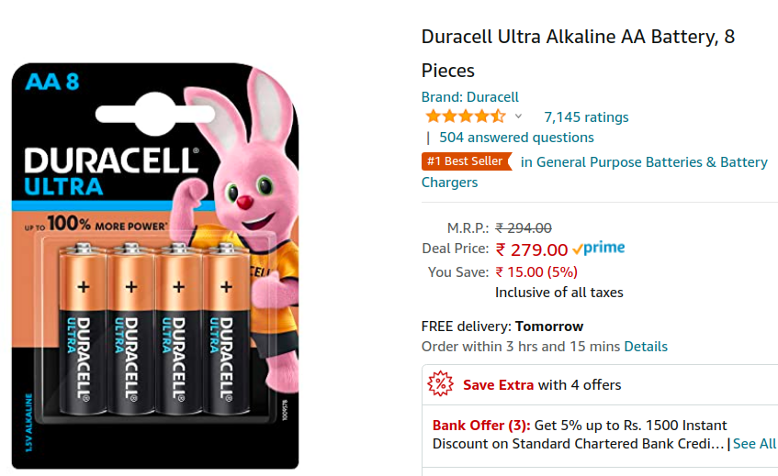
Third party products (3P)
Many products from different 3P brands are sold on Amazon e.g., Duracell.

Slide 11
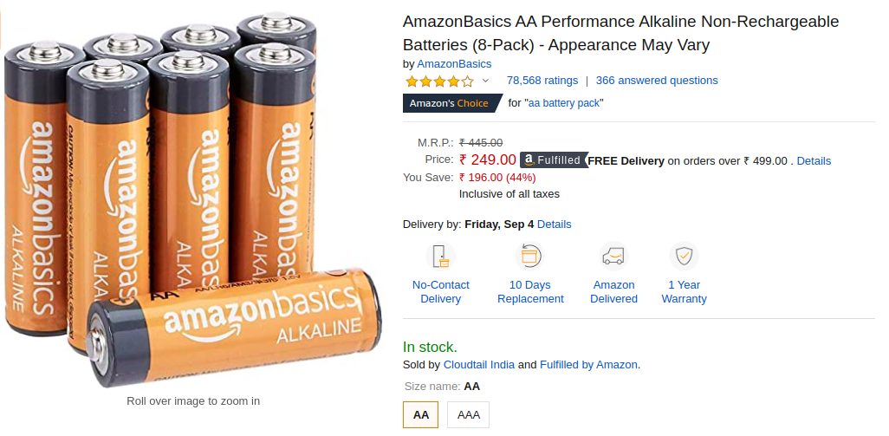
Third party products (3P) Vs. Amazon private labels (PL)
Many products from different 3P brands are sold on Amazon e.g., Duracell.
Amazon also produces its own PL products under brand names e.g., AmazonBasics.

Slide 12
Third party products (3P) Vs. Amazon private labels (PL)
So, the marketplace (Amazon) is in direct competition with other third party (3P) brands on its own platform.
Many products from different 3P brands are sold on Amazon e.g., Duracell.
Amazon also produces its own PL products under brand names e.g., AmazonBasics.

Slide 13
Why is platform important?
Sellers
Products
Customers
Search
Recommendation
PLATFORM: Scale and sophistication
Notes:
You can cover some of the topics mentioned in the later slide here and may be also mention PLs are not new...Offline shops also have PLs but scale sophistication (in data collection and the online environment), power of algorithms make it even worse for e-commerce platforms.

Slide 14
Why is platform important?
Sellers
Products
Customers
E-commerce platforms act both as umpires and players on their own platform / marketplace.
Search
Recommendation
PLATFORM: Scale and sophistication
Notes:
You can cover some of the topics mentioned in the later slide here and may be also mention PLs are not new...Offline shops also have PLs but scale sophistication (in data collection and the online environment), power of algorithms make it even worse for e-commerce platforms.

Slide 15
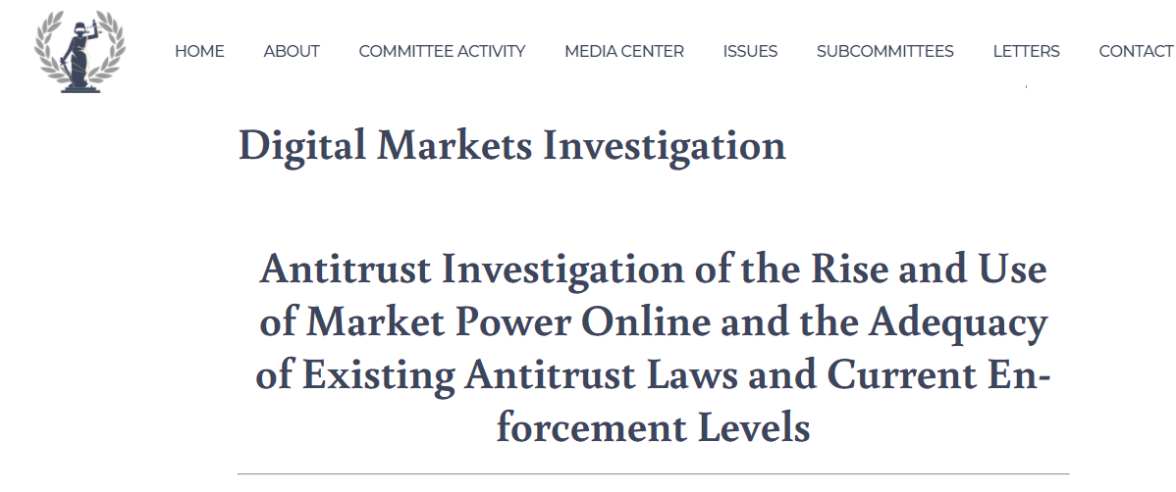
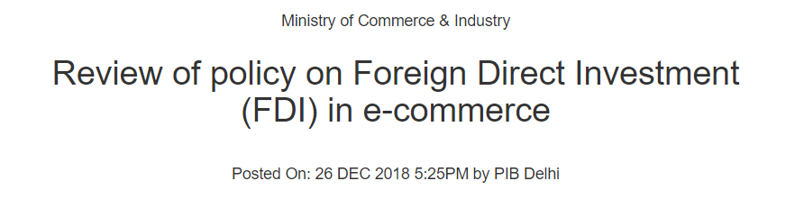

Policymakers across the globe are equally concerned

Slide 16
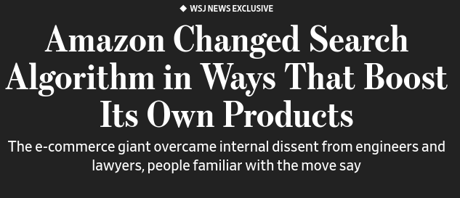
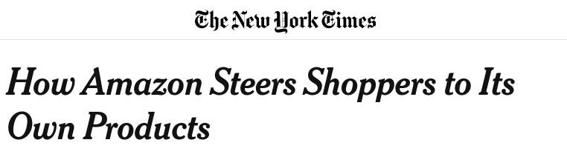
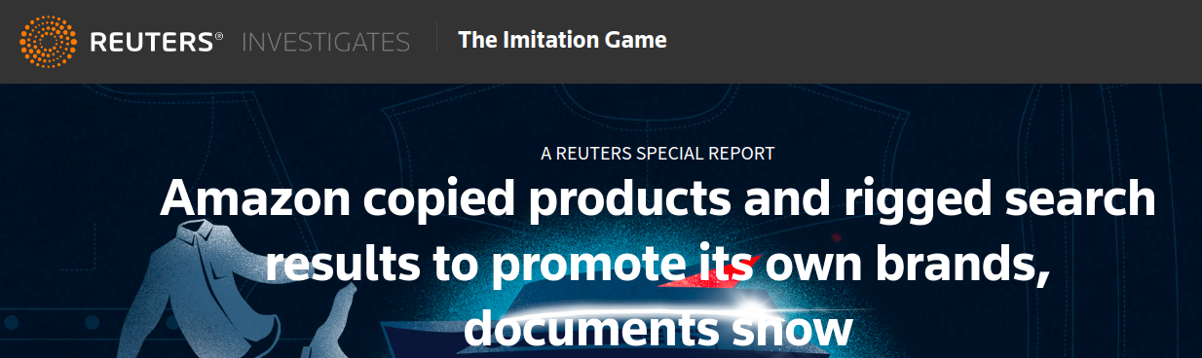
Concerns raised in popular press

Slide 17
Need of the hour
Except media reports raising concerns based on anecdotal evidences, there is no detailed public scrutiny of these practices.
We need a systematic end-to-end audit of the e-commerce ecosystem

Slide 18
These issues also propagate to other modes of interactions with IR algorithms.

Slide 19
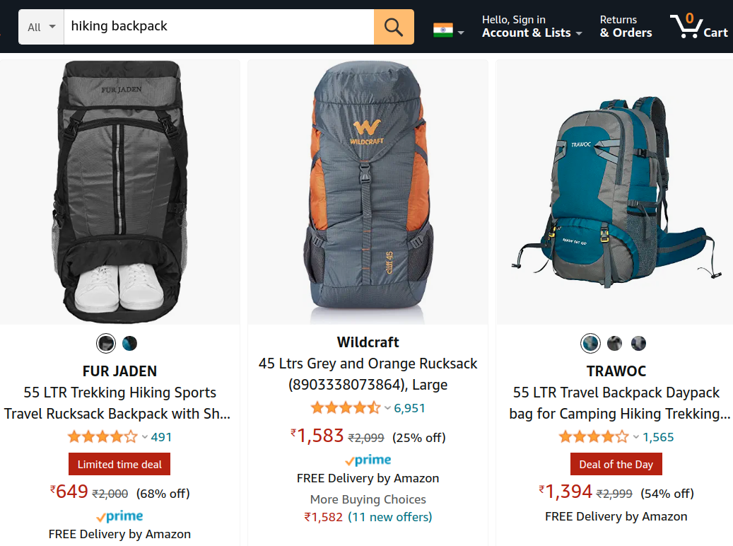
Traditional search

Slide 20
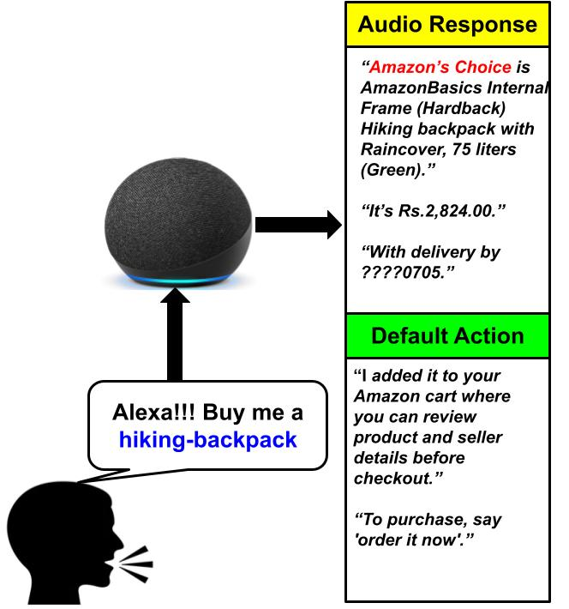
Traditional search Vs. Search through Smart Speakers

Slide 21
Differences in the two modes of interaction
Availability of choices
Autonomy of customers
Such restricted autonomy warrants the voice assistants underlying smart speakers to be more responsible.

Slide 22
Disclaimer
We do not imply these bias / fairness concerns are intentionally induced by algorithm designers or platform organizations.
However, these biases should not go unnoticed.
Identifying and acknowledging their existence is the first step toward mitigation.

Slide 23
Disclaimer
We do not imply these bias / fairness concerns are intentionally induced by algorithm designers or platform organizations.
However, these biases should not go unnoticed.
Identifying and acknowledging their existence is the first step toward mitigation.
Limitation: Most of the audits done are black box in nature.

Slide 24
Disclaimer
We do not imply these bias / fairness concerns are intentionally induced by algorithm designers or platform organizations.
However, these biases should not go unnoticed.
Identifying and acknowledging their existence is the first step toward mitigation.
Limitation: Most of the audits done are black box in nature.
Our aim: A marketplace providing level playing field to all stakeholders.

Slide 25
Research questions addressed in this thesis
How does one quantify bias (if any) induced by related item recommendation algorithms on e-commerce platforms?
How does one generate fair related item recommendations?
How fair and interpretable are the response and default action of voice assistants for e-commerce search queries?

Slide 26
Research questions addressed in this thesis
How does one quantify bias (if any) induced by related item recommendation algorithms on e-commerce platforms?
How does one generate fair related item recommendations?
How fair and interpretable are the response and default action of voice assistants for e-commerce search queries?

Slide 27
Why is platform important?
PRIVATE LABEL PRODUCTS (PLs)
Sellers
Products
Customers
Search
Recommendation
PLs
PLATFORM: Emergence of PLs

Slide 28
This study
This is the first systematic audit of the Amazon ecosystem
Related item recommendations on Amazon
We propose a number of network centric measures to quantify biases
Toward Amazon private label products

Slide 29
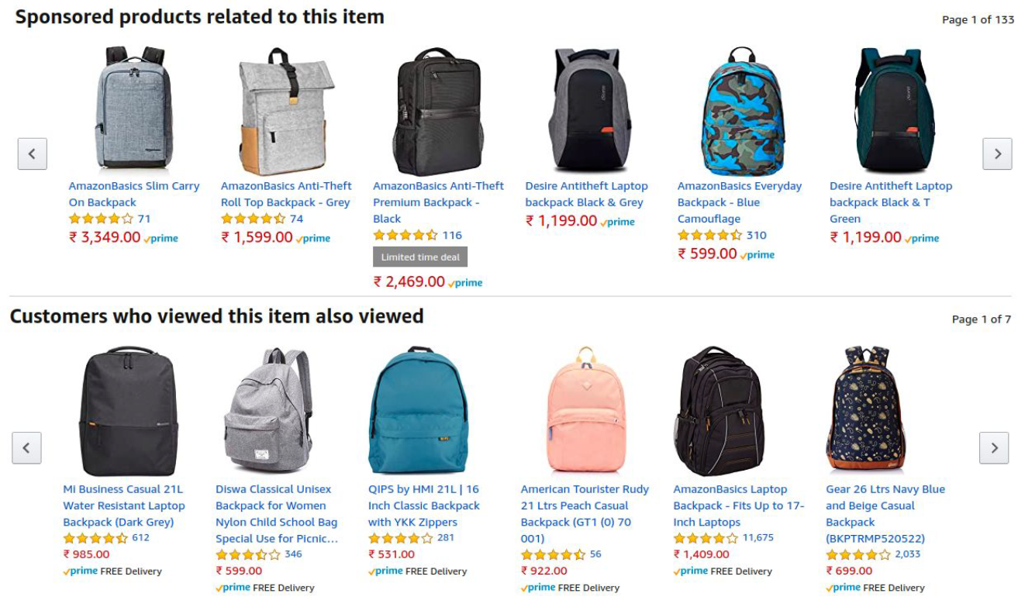
Related item recommendations (RIRs) on Amazon
Sponsored Recommendations
Organic Recommendations
*Screenshot taken from Amazon.in.

Slide 30
Types of products recommended on Amazon
Amazon Private Label products (PL)
*Screenshot taken from Amazon.in.

Slide 31
Types of products recommended on Amazon
Third party products (3P)
*Screenshot taken from Amazon.in.

Slide 32

Concerns regarding sponsored ads
Sponsored advertisements replacing organic recommendations
https://www.marketplacepulse.com/articles/amazon-is-replacing-product-suggestions-with-ads

Slide 33
Concerns regarding sponsored ads
Sponsored advertisements replacing organic recommendations
Survey of 2,000+ Amazon customers show that 50% respondents didn’t even realize being advertised to on Amazon product pages.
Sponsored recommendations offer a powerful option to nudge customers.
https://www.cnbc.com/2019/07/17/how-amazon-advertising-works.html

Slide 34
Concerns regarding sponsored ads
Sponsored advertisements replacing organic recommendations
Survey of 2,000+ Amazon customers show that 50% respondents didn’t even realize being advertised to on Amazon product pages.
Sponsored recommendations offer a powerful option to nudge customers.
Thus biases in the sponsored ads can not be neglected

Slide 35
This study
This is the first systematic audit of the Amazon echo-system
Related item recommendations on Amazon
We propose a number of network centric measures to quantify biases
Toward Amazon private label products
Specifically, we investigate for biases (if any) in the sponsored recommendations on Amazon

Slide 36
Data collection
Categories: Backpack and Battery

Slide 37
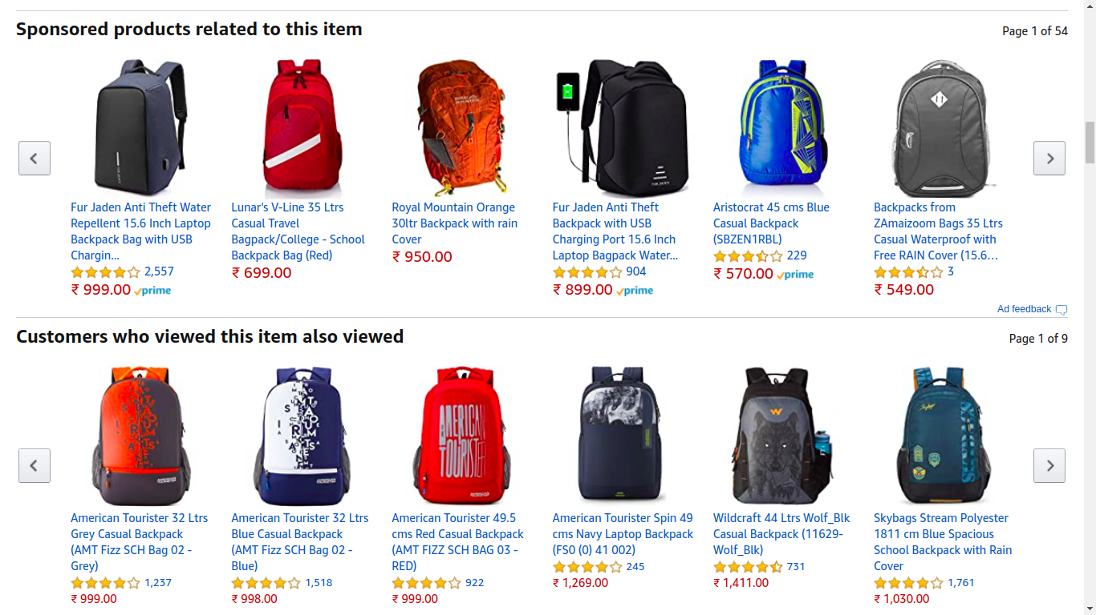
Data collection
Categories: Backpack and Battery
We crawled the Amazon website for data collection.
The recommendations and metadata for each products were collected.
Both organic and sponsored recommendations were collected.
Category | # Items | #PLs
Backpack | 10,775 | 161
Battery | 5,352 | 17

Slide 38
Framework for auditing
recommendation systems

Slide 39
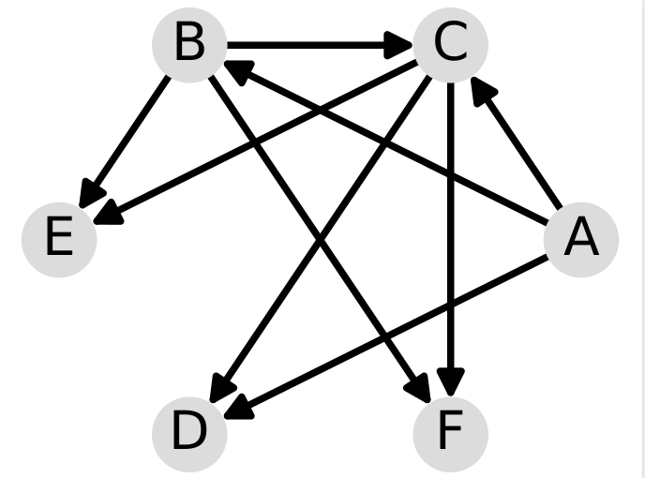
The framework
To understand the recommendation ecosystem, we instantiate related item recommendations as Related Item Network (RIN).
Items | Related items
A | B, C, D
B | E, C, F
C | D, E, F

Slide 40
The framework
To understand the recommendation ecosystem, we instantiate related item recommendations as Related Item Network (RIN).
Items | Related items
A | B, C, D
B | E, C, F
C | D, E, F

Slide 41
Two RINs
RINs constructed from
Sponsored recommendations: Sponsored RIN (S)
Organic recommendations: Organic RIN (O)

Slide 42
Two RINs and the rationale behind it
RINs constructed from
Sponsored recommendations: Sponsored RIN (S)
Organic recommendations: Organic RIN (O)
Difficult to quantify bias in absolute terms; however it is easier provided an unbiased reference for comparison.

Slide 43
Two RINs and the rationale behind it
RINs constructed from
Sponsored recommendations: Sponsored RIN (S)
Organic recommendations: Organic RIN (O)
Difficult to quantify bias in absolute terms; however it is easier provided an unbiased reference for comparison.
Assumption: Organic recommendations are an appropriate representation of user activities.
Aim: Quantification of relative bias (if any) toward PLs in S as compared to O.

Slide 44
Methodologies for evaluation of bias
Promotion bias
Ranking bias
Representation in the core of a network
Exposure bias
Quantifying the influence of the sensitive attribute

Slide 45
Methodologies for evaluation of bias
Promotion bias
Ranking bias
Representation in the core of a network
Exposure bias
Quantifying the influence of the sensitive attribute

Slide 46
Promotion bias

Slide 47
Promotion bias
Amazon PLs get sponsored recommendations from half of the product space.
In organic RIN this percentage drops to 15%.
Amazon PLs are not similar to many products as per the organic customer behavior.

Slide 48
Comparing in-degree of different type of batteries
Properties | Organic RIN | Sponsored RIN
Avg. in-degree of nodes | 11 | 11
Categorization as per products’ relationship with Amazon
Avg. in-degree of private label products | 46 | 520
Avg. in-degree of 3P products | 11 | 09
* All the differences were found to be statistically significant.

Slide 49
Comparing in-degree of different type of batteries
Properties | Organic RIN | Sponsored RIN
Avg. in-degree of nodes | 11 | 11
Categorization as per products’ relationship with Amazon
Avg. in-degree of private label products | 46 | 520
Avg. in-degree of 3P products | 11 | 09
* All the differences were found to be statistically significant.

Slide 50
Comparing in-degree of different type of batteries
Properties | Organic RIN | Sponsored RIN
Avg. in-degree of nodes | 11 | 11
Categorization as per products’ relationship with Amazon
Avg. in-degree of private label products | 46 | 520
Avg. in-degree of 3P products | 11 | 09
* All the differences were found to be statistically significant.

Slide 51
Comparing in-degree of different type of batteries
The degree of promotion of Amazon PLs is significantly higher in the sponsored RIN as compared to organic RIN.
Properties | Organic RIN | Sponsored RIN
Avg. in-degree of nodes | 11 | 11
Categorization as per products’ relationship with Amazon
Avg. in-degree of private label products | 46 | 520
Avg. in-degree of 3P products | 11 | 09
* All the differences were found to be statistically significant.

Slide 52
Exposure bias

Slide 53
Estimating exposure of an item from a RIN
We use the ‘Random Surfer Model’ for exposure estimation.
The steady state visit frequency of an item on the RIN is its exposure.
We account for the following:
User propensity to follow recommendations.
Installation of the long-tail popularity distribution
Presentation bias on the online platform of Amazon.

Slide 54
Different exposures and exposure bias
Organic exposure: Exposure of an item due to organic recommendations on Amazon (E_{o})
Sponsored exposure: Exposure of an item due to sponsored recommendations on Amazon (E_{s})
Exposure bias = KLD (E_{s} || E_{o})

Slide 55
Exposure distortion due to sponsored recommendations

Slide 56
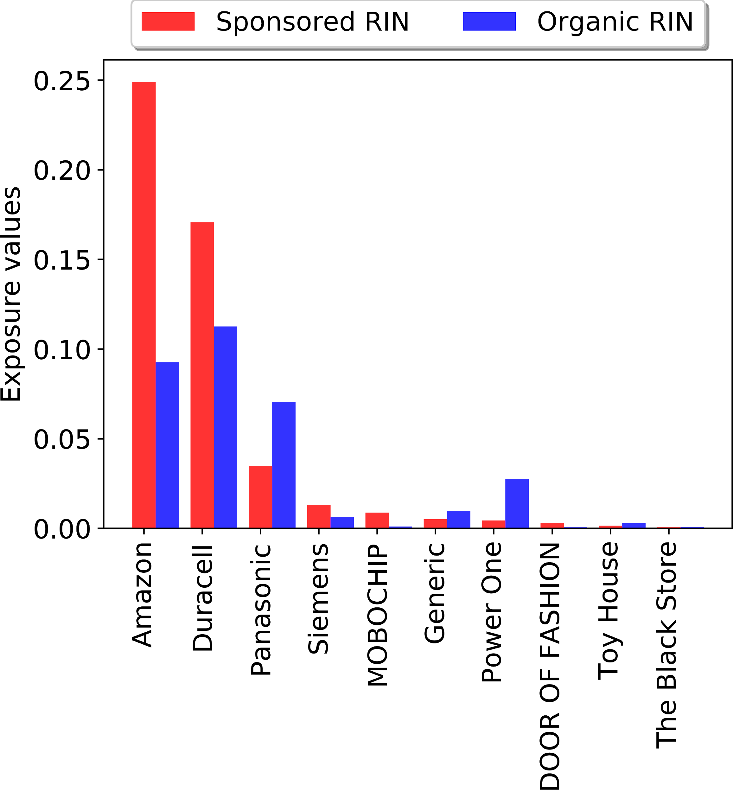
Distortion in exposure for brands on Amazon
Exposure of a brand is evaluated as the sum of exposure of all items of that brand.

Slide 57
Distortion in exposure for brands on Amazon
Amazon private label brands and Duracell saw increase in their exposure in the sponsored RIN.
17 PLs accounted for 25% of the total exposure in sponsored RIN.

Slide 58
Distortion in exposure for brands on Amazon
Top brands like Power One, Generic, and Panasonic saw significant drop in sponsored exposure as compared to their organic exposure.
75% of all brands were underexposed.

Slide 59
Distortion in exposure for brands on Amazon
Top brands like Power One, Generic, and Panasonic see significant drop in sponsored exposure as compared to their organic exposure.
75% of all brands were underexposed.
Amazon private label products are significantly over-exposed in the sponsored RIN as compared to organic RIN.

Slide 60
Methodologies for evaluation of bias
Promotion bias
Ranking bias
Representation in the core of a network
Exposure bias
Quantifying the influence of the sensitive attribute
All the above showed indication of biases toward Amazon private label products.

Slide 61
Why are biases in sponsored recommendations important?
Sponsored Vs. Organic recommendations
Economic aspect of self-sponsorship

Slide 62
Why are biases in sponsored recommendations important?
Sponsored Vs. Organic recommendations
Economic aspect of self-sponsorship
Sponsored recommendations ought to be different from organic ones.
They can have delayed impact on organic recommendations.

Slide 63
Why are biases in sponsored recommendations important?
Sponsored Vs. Organic recommendations
Economic aspect of self-sponsorship
Sponsored recommendations ought to be different from organic ones.
They can have delayed impact on organic recommendations.
Amazon can unilaterally reserve ad-space without being accountable.
This can increase the advertising cost for the remaining ad-space.

Slide 64
Why are biases in sponsored recommendations important?
Sponsored Vs. Organic recommendations
Economic aspect of self-sponsorship
Sponsored recommendations ought to be different from organic ones.
How much deviation is desirable?
They can have delayed impact on organic recommendations.
Hence biases in sponsored recommendations should not go unnoticed.
Some clarity regarding the exact practices are also desirable.
Amazon can unilaterally reserve ad-space without being accountable.
This can increase the advertising cost for the remaining ad-space.

Slide 65
Summary: The umpire is also a player
Umpire: Amazon has the control over the algorithmic systems.
Player: Amazon’s PL products also compete on its platform.

Slide 66
Summary: The umpire is also a player
Umpire: Amazon has the control over the algorithmic systems.
Player: Amazon’s PL products also compete on its platform.
Umpire: Amazon has the control over ad-space allocation.
Player: Ads of Amazon’s PL
products are also shown on Amazon.

Slide 67
Publications from this chapter
A. Dash, A. Chakraborty, S. Ghosh, A. Mukherjee, K. P. Gummadi, When the Umpire is also a Player: Bias in Private Label Product Recommendations on E-commerce Marketplaces, In Proceedings of the ACM Conference on Fairness, Accountability, and Transparency, (ACM FAccT), March, 2021.
A. Dash, A Mukherjee, S. Ghosh, A Network-centric Framework for Auditing Recommendation Systems, In Proceedings of the IEEE International Conference on Computer Communications (IEEE INFOCOM), April, 2019.

Slide 68
Research questions addressed in this thesis
How does one quantify bias (if any) induced by related item recommendation algorithms on e-commerce platforms?
How does one generate fair related item recommendations?
How fair and interpretable are the response and default action of voice assistants for e-commerce search queries?

Slide 69
Exposure bias on Amazon
Special relationships on the platform can lead to exposure biases.
Potential remedy : Policy changes / more succinct regulations.

Slide 70
How to mitigate exposure bias from RIRs?
We should be trying to mitigate exposure bias on Amazon directly.

Slide 71
How to mitigate exposure bias from RIRs?
We should be trying to mitigate exposure bias on Amazon directly.
Algorithms deployed on Amazon are proprietary.

Slide 72
How to mitigate exposure bias from RIRs?
We should be trying to mitigate exposure bias on Amazon directly
Algorithms deployed on Amazon are proprietary.
We do the next best thing by
Investigating for exposure bias (if any) in standard RIR algorithms
Trying to mitigate them
Can exposure bias be implicitly induced due to RIR algorithms?

Slide 73
RIR algorithms and Exposure Bias thereof

Slide 74
Some popular related item recommendation algorithms
ratingSVD
Applies SVD to the user-item rating matrix
Cosine-similarity for similarity evaluation
Notion: people who like this item also like

Slide 75
Some popular related item recommendation algorithms
ratingSVD
Applies SVD to the user-item rating matrix
Cosine-similarity for similarity evaluation
Notion: people who like this item also like
item2vec
Replication of word2vec
Tries to find co-occurrence patterns
Notion: people consume these items together

Slide 76
Some popular related item recommendation algorithms
ratingSVD
Applies SVD to the user-item rating matrix
Cosine-similarity for similarity evaluation
Notion: people who like this item also like
item2vec
Replication of word2vec
Tries to find co-occurrence patterns
Notion: people consume these items together

Slide 77
Datasets utilised
MovieLens 10M
10M ratings
71K different users
10K distinct movies
Amazon review dataset
194K ratings
27K different users
10K different products

Slide 78
Datasets utilised
MovieLens 10M
10M ratings
71K different users
10K distinct movies
Amazon review dataset
194K ratings
27K different users
10K different products

Slide 79
Related Item Network
To understand the recommendation ecosystem, we instantiate related item recommendations as Related Item Network (RIN).
Items | Related items
A | B, C, D
B | E, C, F
C | D, E, F

Slide 80
Estimating observed exposure of an item from a RIN
We use the ‘Random Surfer Model’ for exposure estimation.
The steady state visit frequency of an item on the RIN is its exposure.

Slide 81
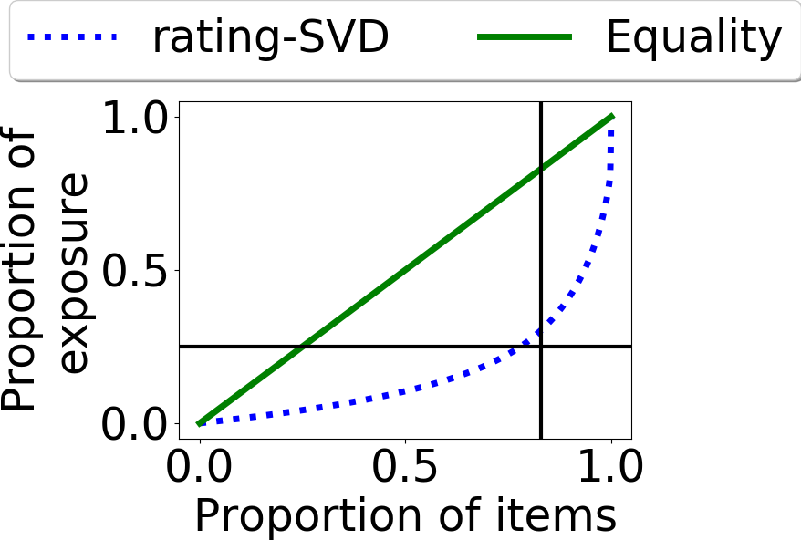
Skew in exposure of items
X axis: Cumulative proportion of items in increasing order of their exposure (left to right)
Y axis: Cumulative proportion of exposure distribution

Slide 82
Skew in exposure of items
Top 25% of the items with most exposure in the Amazon dataset account for 75% of the entire exposure.

Slide 83
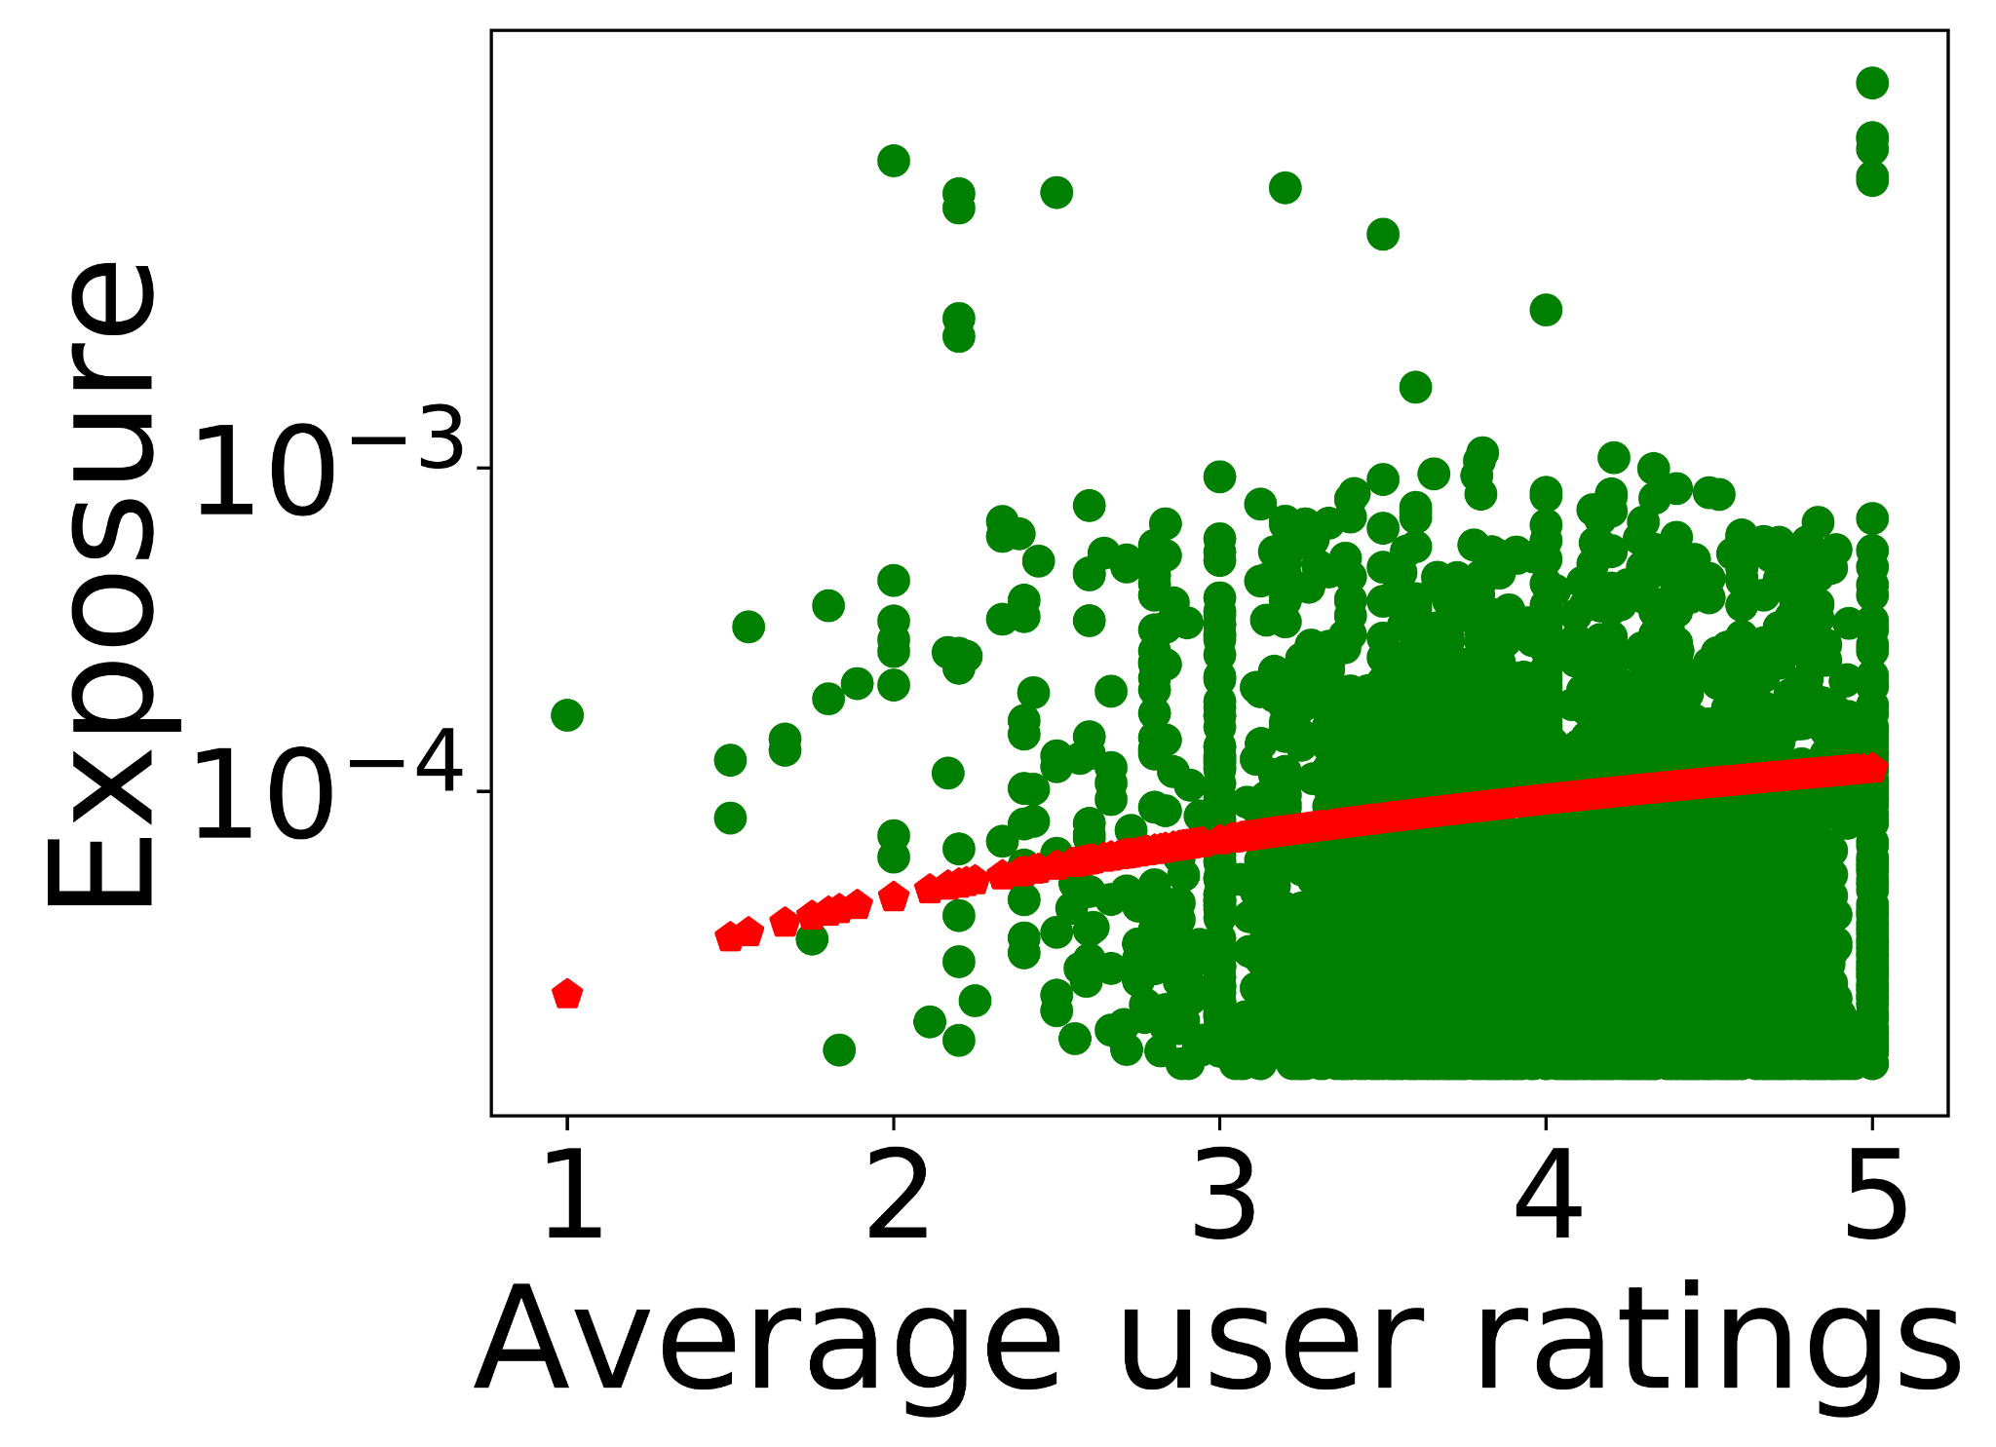
Does gap in quality explain such higher exposure?
X axis: Average user ratings of an item
Y axis: Observed exposure (in log scale) of the corresponding item
Red curve: log plot of quality distribution

Slide 84
Does gap in quality explain such higher exposure?
Only 6-7% of the item set has comparable quality and exposure.

Slide 85
What can be potential reasons?
A poor quality item is recommended from the web page of a high quality item. Such items may get some exposure thanks to that of their source items.
This phenomenon may get reinforced over time.

Slide 86
What is a desired exposure of an item?
Equal for all: Equality of exposure
Proportional to quality: Meritocratic fairness
Or some middle ground?

Slide 87
What is a desired exposure of an item?
Equal for all: Equality of exposure
Proportional to quality: Meritocratic fairness
Or some middle ground?
We perceive desired exposure as a necessary controllable knob.

Slide 88

Desired exposure as a control knob
𝞫 = 1.0→ Equal Exposure

Slide 89

Desired exposure as a control knob
𝞫 = 1.0→ Equal Exposure
𝞫 = 0.0→ Meritocracy

Slide 90

Desired exposure as a control knob
𝞫 = 1.0→ Equal Exposure
𝞫 = 0.25→ 25% of exposure is equally distributed and rest is distributed proportional to merit of the products.
𝞫 = 0.0→ Meritocracy

Slide 91
Desired exposure as a control knob
Two goals for our mitigation strategy
Maintain the relatedness of underlying recommendations
Minimize / Mitigate the induced exposure bias
𝞫 = 1.0→ Equal Exposure
𝞫 = 0.25→ 25% of exposure is equally distributed and rest proportional to merit.
𝞫 = 0.0→ Meritocracy

Slide 92
Fairness intervention mechanisms

Slide 93
FaiRIR: Suite of fair RIR algorithms
FaiRIR_{rl} : Change the latent space representation such that items with similar desired exposure come closer in the latent space.
FaiRIR_{sim} : Desired exposure based similarity metric
FaiRIR_{nbr}: Select neighboring items based on similarity score and desired exposures.

Slide 94
FaiRIR: Suite of fair RIR algorithms
FaiRIR_{rl} : Change the latent space representation such that items with similar desired exposure come closer in the latent space. [Pre-processing]
FaiRIR_{sim} : Desired exposure based similarity metric [In-processing]
FaiRIR_{nbr}: Select neighboring items based on similarity score and desired exposures. [Post-processing]

Slide 95
FaiRIR: Suite of fair RIR algorithms
FaiRIR_{rl} : Change the latent space representation such that items with similar desired exposure come closer in the latent space. [Pre-processing]
FaiRIR_{sim} : Desired exposure based similarity metric [In-processing]
FaiRIR_{nbr}: Select neighboring items based on similarity score and desired exposures. [Post-processing]

Slide 96
Fair representation learning
Inputs:
X : representation learnt from standard RIR algorithms
X : representation encoding desired exposure
(Derived from a Desiredness Graph)
Goal:
X~: Fair representation reconciling relatedness and desiredness

Slide 97
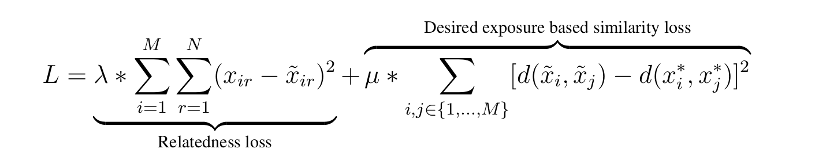
Loss function
Relatedness loss: Reconstruction loss to be minimized to preserve as much relatedness information learnt as possible.
Desired exposure based similarity loss: Distance between two items i and j should be preserved in the learnt latent space based on their desired exposure.

Slide 98
Effectiveness in mitigating exposure bias
While only 7% items were getting adequate exposure earlier, now 23% get adequate exposure.
Method | Exposure bias
Vanilla rating-SVD | 1.28
FaiRIR_{rl} | 0.18
*Exposure bias = KLD (E_{observed} || E_{desired})

Slide 99
Fair neighbor selection
We maintain two ranked-list of items based on their
Relatedness
Desired exposure
Reconcile between the two: Rank aggregation method based on Borda count
Intuition: Any item having higher rank in both the ranked lists should be considered the most suitable related item for the given item.

Slide 100
Effectiveness in mitigating exposure bias
While only 7% items were getting adequate exposure earlier, now 100% get adequate exposure.
Method | Exposure bias
Vanilla rating-SVD | 1.28
FaiRIR_{nbr} | 0.002
*Exposure bias = KLD (E_{observed} || E_{desired})

Slide 101
Effectiveness in mitigating exposure bias
While only 7% items were getting adequate exposure earlier, now 100% get adequate exposure.
Mitigation strategies are effective in reducing exposure bias. However, do we have to pay a huge cost in terms of relatedness of the recommendations?
Method | Exposure bias
Vanilla rating-SVD | 1.28
FaiRIR_{nbr} | 0.002
*Exposure bias = KLD (E_{observed} || E_{desired})

Slide 102
Evaluation of Relatedness

Slide 103
Does mitigation of biases come at the cost of relatedness?
Genre / Category based similarity
Users’ propensity to like recommended items
User survey to judge the goodness of recommendations
Based on the given datasets

Slide 104
Does mitigation of biases come at the cost of relatedness?
Genre / Category based similarity
Users’ propensity to like recommended items
User survey to judge the goodness of recommendations
Based on the given datasets

Slide 105
Design choices of the user survey
We consider the top 5% most popular movies (based on #Ratings).
We also provide the link to IMDb information page to ensure more reliability.
Notes:
Say why we did this survey with movies.

Slide 106
Design choices of the user survey
We consider the top 5% most popular movies (based on #Ratings).
We also provide the link to IMDb information page to ensure more reliability.
For a particular source movie (x)
Generate top-5 recommendations using various algorithms (y).
If your friend likes movie x, how likely are you to recommend movie y?
Likert scale of [1, 5] (1-- very unlikely, 5-- very likely)
The recommendations were anonymized.
Notes:
Say why we did this survey with movies.

Slide 107
Survey platform
We performed the survey on Amazon Mechanical Turk.
Recommendations for 100 different source movies were evaluated.
1550 distinct source-recommended movie pairs were evaluated.
Each pair was evaluated by at least 10 AMT master workers.

Slide 108
Mean relevance score
We evaluate the mean relevance score based on the score each recommended movie received from the AMT workers for the source movies.

Slide 109
Mean relevance score
We evaluate the mean relevance score based on the score each recommended movie received from the AMT workers for the source movies.
Variant of the RIR Algorithm (rating-SVD) | Mean Relevance Score
Vanilla | 3.73
FaiRIR_{rl} | 2.69
FaiRIR_{sim} | 3.63
FaiRIR_{nbr} | 3.62

Slide 110
Mean relevance score
We evaluate the mean relevance score based on the score each recommended movie received from the AMT workers for the source movies.
Proposed intervention mechanisms successfully mitigate exposure bias without sacrificing much on relatedness.
Variant of the RIR Algorithm (rating-SVD) | Mean Relevance Score
Vanilla | 3.73
FaiRIR_{rl} | 2.69
FaiRIR_{sim} | 3.63
FaiRIR_{nbr} | 3.62

Slide 111
Publication from this chapter
A. Dash, A. Chakraborty, S. Ghosh, A. Mukherjee, K. P. Gummadi, FaiRIR: Mitigating Exposure Bias from Related Item Recommendations in Two-Sided Platforms,
IEEE Transactions on Computational Social Systems (IEEE TCSS), April, 2022.

Slide 112
Research questions addressed in this thesis
How does one quantify bias (if any) induced by related item recommendation algorithms on e-commerce platforms?
How does one generate fair related item recommendations?
How fair and interpretable are the response and default action of voice assistants for e-commerce search queries?

Slide 113
Till now
We observe biases in environments where choices are served in abundance.
Related Item Recommendation
We proposed methodologies to mitigate those biases.
The observations are valid for traditional mediums e.g., Desktop search etc..

Slide 114
Traditional e-commerce search
Customers enter query strings
A ranked list of products appear
Decreasing order of relevance
Metadata of the products shown
Customers have multiple options to choose from

Slide 115
E-commerce search through Smart Speakers
Smart speakers are powered by voice assistants (VAs)
Customers utter a query string
The details of a single product is told
Audio response with a brief explanation
Default action of adding the product to cart
https://mindstreammediagroup.com/introduction-smart-speakers-voice-search-brand-advertisers/

Slide 116
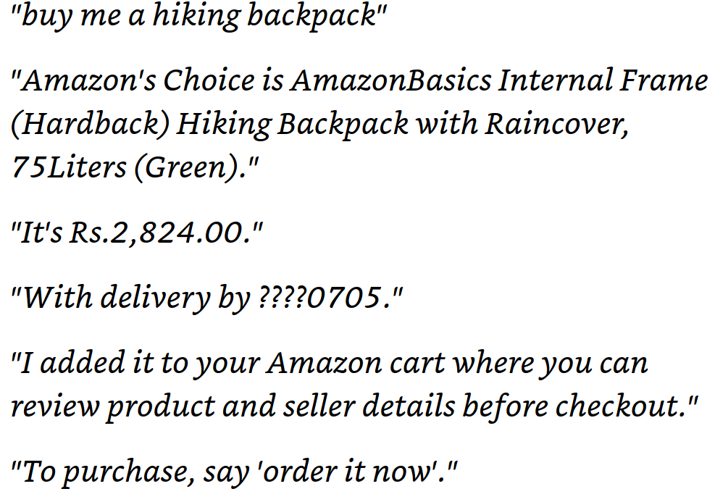
Audio responses from Alexa

Slide 117
Audio responses from Alexa
Query string

Slide 118
Audio responses from Alexa
Query string
Product details

Slide 119
Audio responses from Alexa
Query string
Brief explanation
Product details

Slide 120
Audio responses from Alexa
Query string
Brief explanation
Product details
Default action

Slide 121
E-commerce search through Smart Speakers
Smart speakers are powered by voice assistants (VAs)
Customers utter a query string
The details of a single product is told
Audio response with a brief explanation
Default action of adding the product to cart
Unlike traditional product search, customers do not have many options to choose from.
https://mindstreammediagroup.com/introduction-smart-speakers-voice-search-brand-advertisers/

Slide 122
In this paper
RQ 1: How do customers interpret the explanations given in the audio response by the VA?
RQ 2: How fair is the default action by the VA?

Slide 123
Why are these questions important?

Slide 124
Gap in explanation and Interpretation of customers

Slide 125

Gap in explanation and Interpretation of customers
Alexa buy me a backpack
A top result is P …
Aah!!! Nice! It must be very good as Alexa said it is the top result on Amazon.

Slide 126
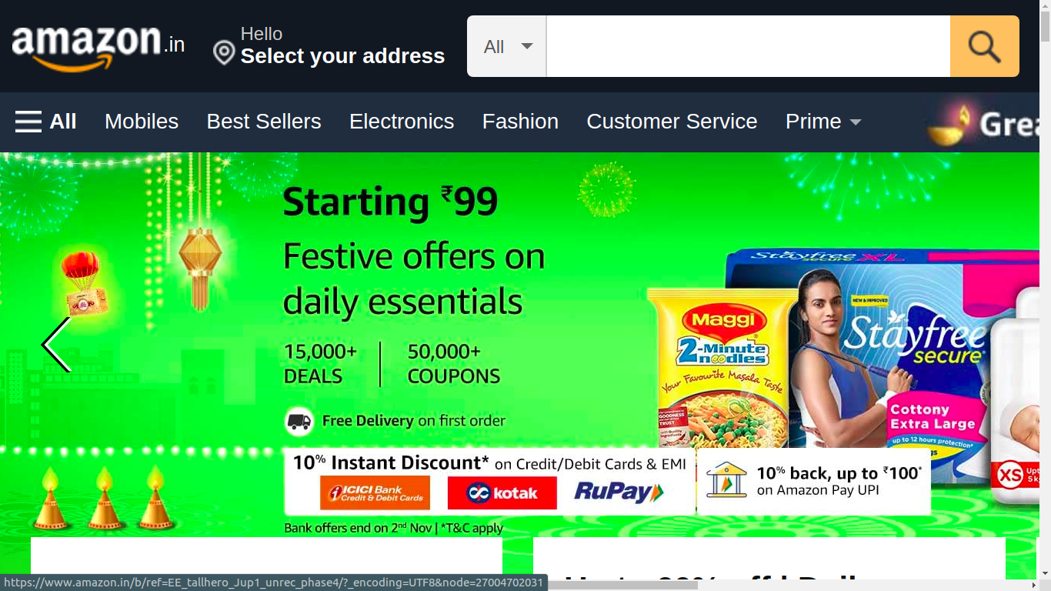
Gap in explanation and Interpretation of customers
Alexa buy me a backpack
backpack
A top result is P …
Aah!!! Nice! It must be very good as Alexa said it is the top result on Amazon.
But, P is not even in the first SERP on Amazon. How did Alexa say it is `a top result’?

Slide 127
Fairness in the default action by VA
VA selects one specific product as part of its default action
Customers have a tendency to take the path of less effort.
Default option often comes as an endorsement from the choice architect.
Hence, likelihood of choosing / purchasing the default option is generally high.
Thaler, Richard H., and Cass R. Sunstein. "Nudge: Improving decisions about health, wealth, and happiness."

Slide 128
Fairness in the default action by VA
VA selects one specific product as part of its default action
Customers have a tendency to take the path of less effort.
Default option often comes as an endorsement from the choice architect.
Hence, likelihood of choosing / purchasing the default option is generally high.
Non-selection of the most relevant product as the default choice
may deny its producers sales and revenue opportunities
may mislead customers to (possibly) less relevant products

Slide 129
Research questions
RQ 1: How do customers interpret the explanations given in the audio response by the VA?
RQ 2: How fair is the default action by the VA?

Slide 130
Challenges in understanding customers interpretation
These explanations have several semantics and nuances attached
Customers are more conversant with traditional mediums e.g., Desktop e-commerce search.
https://tinuiti.com/wp-content/uploads/2020/03/2020_Amazon_Shopper_Survey_02.pdf

Slide 131
Challenges in understanding customers interpretation
These explanations have several semantics and nuances attached
Customers are more conversant with traditional mediums e.g., Desktop e-commerce search.
One way is to contrast the customers’ interpretation of the explanations with observations on desktop search.
https://tinuiti.com/wp-content/uploads/2020/03/2020_Amazon_Shopper_Survey_02.pdf

Slide 132
Challenges in understanding customers interpretation
These explanations have several semantics and nuances attached
Customers are more conversant with traditional mediums e.g., Desktop e-commerce search.
One way is to contrast the customers’ interpretation of the explanations with observations on desktop search.
How to design an effective data collection framework for such analysis?
https://tinuiti.com/wp-content/uploads/2020/03/2020_Amazon_Shopper_Survey_02.pdf

Slide 133
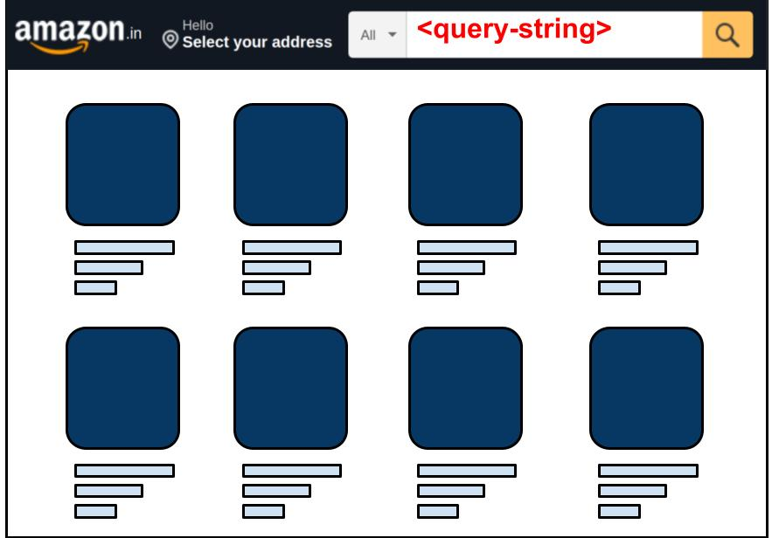
Data collection for a meaningful comparison
Audio Response
--------------
--------------
Default Action
Google text to speech
--------------
--------------
Product details
Query String
Product details

Slide 134
Data collection for a meaningful comparison
Audio Response
--------------
--------------
Query string
Default Action
Google text to speech
--------------
--------------
Product details
Query String
Product details

Slide 135
Data collection for a meaningful comparison
Audio Response
--------------
--------------
Query string
gTTS to generate audio command
Default Action
Google text to speech
--------------
--------------
Product details
Query String
Product details

Slide 136
Data collection for a meaningful comparison
Audio Response
--------------
--------------
Query string
gTTS to generate audio command
At the same time search on Alexa and desktop
Default Action
Google text to speech
--------------
--------------
Product details
Query String
Product details

Slide 137
Data collection for a meaningful comparison
Audio Response
--------------
--------------
Query string
gTTS to generate audio command
At the same time search on Alexa and desktop
Get the audio response and desktop SERP
Default Action
Google text to speech
--------------
--------------
Product details
Query String
Product details

Slide 138
Data collection for a meaningful comparison
Audio Response
--------------
--------------
Query string
gTTS to generate audio command
At the same time search on Alexa and desktop
Get the audio response and desktop SERP
Collect the product details
Default Action
Google text to speech
--------------
--------------
Product details
Query String
Product details

Slide 139
Some statistics of the dataset collected
We selected the top-100 keywords searched on Amazon and extended it to a set of 1000 queries for our data collection.
We collected data for 1000 query strings on Amazon.
We also collected 14 temporal snapshots for top-100 queries on Amazon.
The queries cover 10 popular product categories on Amazon.

Slide 140
Some statistics of the dataset collected
We selected the top-100 keywords searched on Amazon and extended it to a set of 1000 queries for our data collection.
We collected data for 1000 query strings on Amazon.
We also collected 14 temporal snapshots for top-100 queries on Amazon.
The queries cover 10 popular product categories on Amazon.
For access to dataset, please refer to the form at this link: https://forms.gle/aEG2n84Ay82QkVD19

Slide 141
Most prevalent explanations
66% queries out of 1000

Slide 142
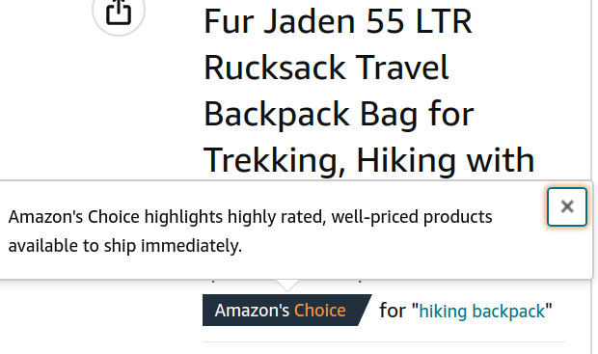
Most prevalent explanations
Amazon’s choice highlights highly rated, well-priced products available to ship immediately.
66% queries out of 1000

Slide 143
User survey for understanding interpretation
We conducted a survey among 100 participants.
Most of them are conversant with Amazon platform.

Slide 144
User survey for understanding interpretation
We conducted a survey among 100 participants.
Most of them are conversant with Amazon platform.
We asked them different questions pertaining to
What do customers interpret by `highly rated’ (or `well priced’) products?
Where do customers expect Amazon’s Choice products to appear?
How likely are you to buy the product which is explained as “Amazon’s Choice”?

Slide 145
What do customers interpret by `highly rated’ product?
According to 59% respondents, a product with avg. rating greater than 4.0 out of 5.0 can be considered highly rated.

Slide 146
What do customers interpret by `highly rated’ product?
According to 59% respondents, a product with avg. rating greater than 4.0 out of 5.0 can be considered highly rated.
In all the 662 queries, the product selected with Amazon’s choice explanation has an average rating greater than 4.0.

Slide 147
What do customers interpret by `well priced’ product?
61% respondents consider a product with price among the least 5 prices among all the products shown in SERP to be well priced.

Slide 148
What do customers interpret by `well priced’ product?
61% respondents consider a product with price among the least 5 prices among all the products shown in SERP to be well priced.
In merely 23% cases, product added to cart adhered to the most common interpretation as mentioned above.

Slide 149


Major takeaways from the survey
Explanation type | Statement | Interpretation (% votes) | Match
Amazon’s Choice | Highly rated | Avg. user rating ≥ 4.0 (59%) | (100%) (00%)
 | Well priced | Least-5 price (61%) | (23%) (77%)
 | Expected position | Top-5 in SERP (54%) | (74%) (26%)
A top result | Expected position | Top result (position 1) (62%) | (19%) (81%)

Slide 150
Major takeaways from the survey
Respondents’ interpretations of the VA’s explanation do not align with observations from desktop search results in majority of the cases.
Explanation type | Statement | Interpretation | Match
Amazon’s Choice | Highly rated | Avg. user rating ≥ 4.0 | (100%) (00%)
 | Well priced | Least-5 price | (23%) (77%)
 | Expected position | Top-5 in SERP | (74%) (26%)
A top result | Expected position | Top result (position 1) | (19%) (81%)

Slide 151
Major takeaways from the survey
Respondents’ interpretations of the VA’s explanation do not align with observations from desktop search results in majority of the cases.
Additionally, 56% customers answered that they are likely or very likely to purchase products with such explanations.
Explanation type | Statement | Interpretation | Match
Amazon’s Choice | Highly rated | Avg. user rating ≥ 4.0 | (100%) (00%)
 | Well priced | Least-5 price | (23%) (77%)
 | Expected position | Top-5 in SERP | (74%) (26%)
A top result | Expected position | Top result (position 1) | (19%) (81%)

Slide 152
Research questions
RQ 1: How do customers interpret the explanations given in the audio response by the VA?
RQ 2: How fair is the default action by the VA?

Slide 153
(Un)Fairness toward customers
Is the product added to cart by Alexa also preferred by customers?
We conducted a user survey among the same 100 respondents
We showed the customers:
Product that was added to cart by Alexa
Product that appeared as the top result in the corresponding desktop search
Which of the following two products would you prefer to buy?

Slide 154
Observation
For 22 out of the 30 queries (73.3%), the majority preference of respondents did not match with the products selected by Alexa.
Out of the 1000 evaluations, we find that in 73.2% cases, respondents preferred the top desktop search result to the product selected by Alexa.

Slide 155
Observation
For 22 out of the 30 queries (73.3%), the majority preference of respondents did not match with the products selected by Alexa.
Out of the 1000 evaluations, we find that in 73.2% cases, respondents preferred the top desktop search result to the product selected by Alexa.
These observations further underpin the potential unfairness and customer dissatisfaction concerns due to default product selection of Alexa.

Slide 156
Summary
There exists significant gap in customers’ interpretation of Alexa’s explanations and observation in traditional desktop search.
The default product selection of Alexa has potential unfairness concerns for both customers and producers / sellers.
Since customers cede complete autonomy to smart speakers (and the VAs therein), VAs should be more responsible during such interactions.

Slide 157
Publication from this chapter
A. Dash, A. Chakraborty, S. Ghosh, A. Mukherjee, K. P. Gummadi, Alexa, in you, I trust! Fairness and Interpretability Issues in E-commerce Search through Smart Speakers, In Proceedings of The ACM Web Conference (WWW), April, 2022.

Slide 158
Future directions
Special relationships beyond the private labels need thorough investigation.
More robust fair recommender systems need to be designed which consider
Customers
Producers / Sellers
Platform
And their special relationships
Design choices and algorithms need to be improved when customers interact with digital systems esp., when customers’ autonomy is reduced.

Slide 159
Publications from the thesis (reverse chronology)
A. Dash, A. Chakraborty, S. Ghosh, A. Mukherjee, K. P. Gummadi, FaiRIR: Mitigating Exposure Bias from Related Item Recommendations in Two-Sided Platforms, IEEE Transactions on Computational Social Systems (IEEE TCSS), April, 2022.
A. Dash, A. Chakraborty, S. Ghosh, A. Mukherjee, K. P. Gummadi, Alexa, in you, I trust! Fairness and Interpretability Issues in E-commerce Search through Smart Speakers, In Proceedings of The ACM Web Conference (WWW), April, 2022.
A. Dash, A. Chakraborty, S. Ghosh, A. Mukherjee, K. P. Gummadi, When the Umpire is also a Player: Bias in Private Label Product Recommendations on E-commerce Marketplaces, In Proceedings of the ACM Conference on Fairness, Accountability, and Transparency, (ACM FAccT), March, 2021.
A. Dash, A Mukherjee, S. Ghosh, A Network-centric Framework for Auditing Recommendation Systems, In Proceedings of the IEEE International Conference on Computer Communications (IEEE INFOCOM), April, 2019.

Slide 160
Thesis organization
Chapter 1 : Introduce and motivate the line of work in the dissertation
Chapter 2 : Surveys the relevant related works
Chapter 3 : Introduces RIN framework and performs an audit of Amazon RIN
Chapter 4 : Proposes fair related item recommendation algorithms (FaiRIR)
Chapter 5 : Introduces fairness and interpretability concerns in conversational e-commerce search via smart speakers
Chapter 6 : Summarizes the contributions and future directions

Slide 161
Acknowledgement
Collaborators
Prof. Krishna P. Gummadi (MPI-SWS)
Dr. Abhijnan Chakraborty (IIT Delhi))
TCS RSP
Microsoft, ACM IARCS, SIGCHI Gary Marsden Student Development Fund
CNeRG, IIT Kharagpur

Slide 162
All publications (reverse chronology)
A. Dash, A. Chakraborty, S. Ghosh, A. Mukherjee, K. P. Gummadi, FaiRIR: Mitigating Exposure Bias from Related Item Recommendations in Two-Sided Platforms, IEEE Transactions on Computational Social Systems (IEEE TCSS), April, 2022.
A. Dash, A. Chakraborty, S. Ghosh, A. Mukherjee, K. P. Gummadi, Alexa, in you, I trust! Fairness and Interpretability Issues in E-commerce Search through Smart Speakers, In Proceedings of The ACM Web Conference (WWW), April, 2022.
S. D. Jaiswal, K Duggirala, A. Dash, A. Mukherjee, Two-Face: Adversarial Audit of Commercial Face Recognition Systems, To be published in Proceedings of the International Conference On Web and Social Media (AAAI ICWSM), June, 2022.
A. Dash, A. Chakraborty, S. Ghosh, A. Mukherjee, K. P. Gummadi, When the Umpire is also a Player: Bias in Private Label Product Recommendations on E-commerce Marketplaces, In Proceedings of the ACM Conference on Fairness, Accountability, and Transparency, (ACM FAccT), March, 2021.
A. Shandilya, A.Dash, A. Chakraborty, K. Ghosh and S. Ghosh, Fairness for Whom? Understanding the Reader's Perception of Fairness in Text Summarization, International Workshop on Fair and Interpretable Learning Algorithms (FILA 2020), In conjunction with IEEE BigData, December, 2020.
A. Dash, A Shandilya, A. Biswas, K. Ghosh, S. Ghosh, A. Chakraborty, Summarizing User-generated Textual Content: Motivation and Methods for Fairness in Algorithmic Summaries, In Proceedings of the ACM on Human-Computer Interaction, vol. 3, No. CSCW, Article 172, November 2019.
A. Dash, A Mukherjee, S. Ghosh, A Network-centric Framework for Auditing Recommendation Systems, In Proceedings of the IEEE International Conference on Computer Communications (IEEE INFOCOM), April, 2019.

Slide 163
Thank You

Slide 164
`Amazon’s Choice’ and special relationships
When Amazon PL products appear in search results, for 45% queries they are added to cart with Amazon’s Choice explanation.
78% products added to cart with Amazon’s choice explanation were sold by Amazon Special Merchants. (Cloudtail or Appario)
Future work: The intricacies of conversational medium and effect of special relationships in response and product selection.
Notes:
Just to tie this work a bit with the nuances discussed earlier.

Slide 165
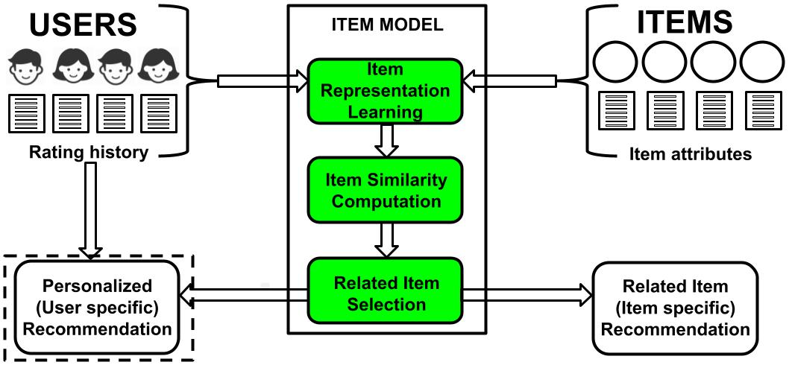
Block diagram of RIR algorithms

Slide 166
Why post-processing method is so effective?
#Recommendations an item gets become proportional to its desired exposure.
Post-processing method does not alter the learnt representation of vanilla RIRs.
Pre-processing methods are often application agnostic.

Slide 167
Where do customers expect Amazon’s Choice products to appear?
54% respondents expect them to appear in top-5 positions; while 30% respondents expect them to appear as the top search result.

Slide 168
Where do customers expect Amazon’s Choice products to appear?
54% respondents expect them to appear in top-5 positions; while 30% respondents expect them to appear as the top search result.
In 74% cases, Amazon’s Choice product appeared in the top-5 positions.

Slide 169
Where do customers expect Amazon’s Choice products to appear?
54% respondents expect them to appear in top-5 positions; while 30% respondents expect them to appear as the top search result.
In 74% cases, Amazon’s Choice product appeared in the top-5 positions.
The contribution from position 1 is merely 39%.
Worse, nearly 8% of the times, it does not even appear in the first SERP.

Slide 170
(Un)Fairness toward producers
Exposure due to Alexa:
1 if product is added to cart, 0 otherwise
Exposure due to ranked results of desktop search
Can be evaluated using any standard attention distribution mechanism
We assume attention / exposure are distributed geometrically
Exposure bias is the difference between the two exposures
Ideally, Exposure bias ≃ 0.

Slide 171
Observation
In 68% of all 1000 queries, exposure bias is non-zero →most relevant product according to desktop search was not added to cart by Alexa.

Slide 172
Observation
In 68% of all 1000 queries, exposure bias is non-zero →most relevant product according to desktop search was not added to cart by Alexa.
Less relevant products were added to cart; thus, depriving producers of more relevant products an opportunity to potential sales and revenue.

Slide 173
Summary
We show how sponsored recommendations on Amazon are being used to nudge users toward Amazon private labels.
Promotion of private labels is by no means illegal.
It is concerning because marketplaces e.g., Amazon are involved in both production and dissemination of products.

Slide 174
Summary
We show how existing RIR algorithms can implicitly induce exposure bias.
Most often the exposure bias can not be explained by the quality of the products.
We propose three mitigation strategies as interventions in the RIR pipeline.
Our proposed mechanisms reduces exposure bias without sacrificing much on the relatedness of the recommendations.

Slide 175
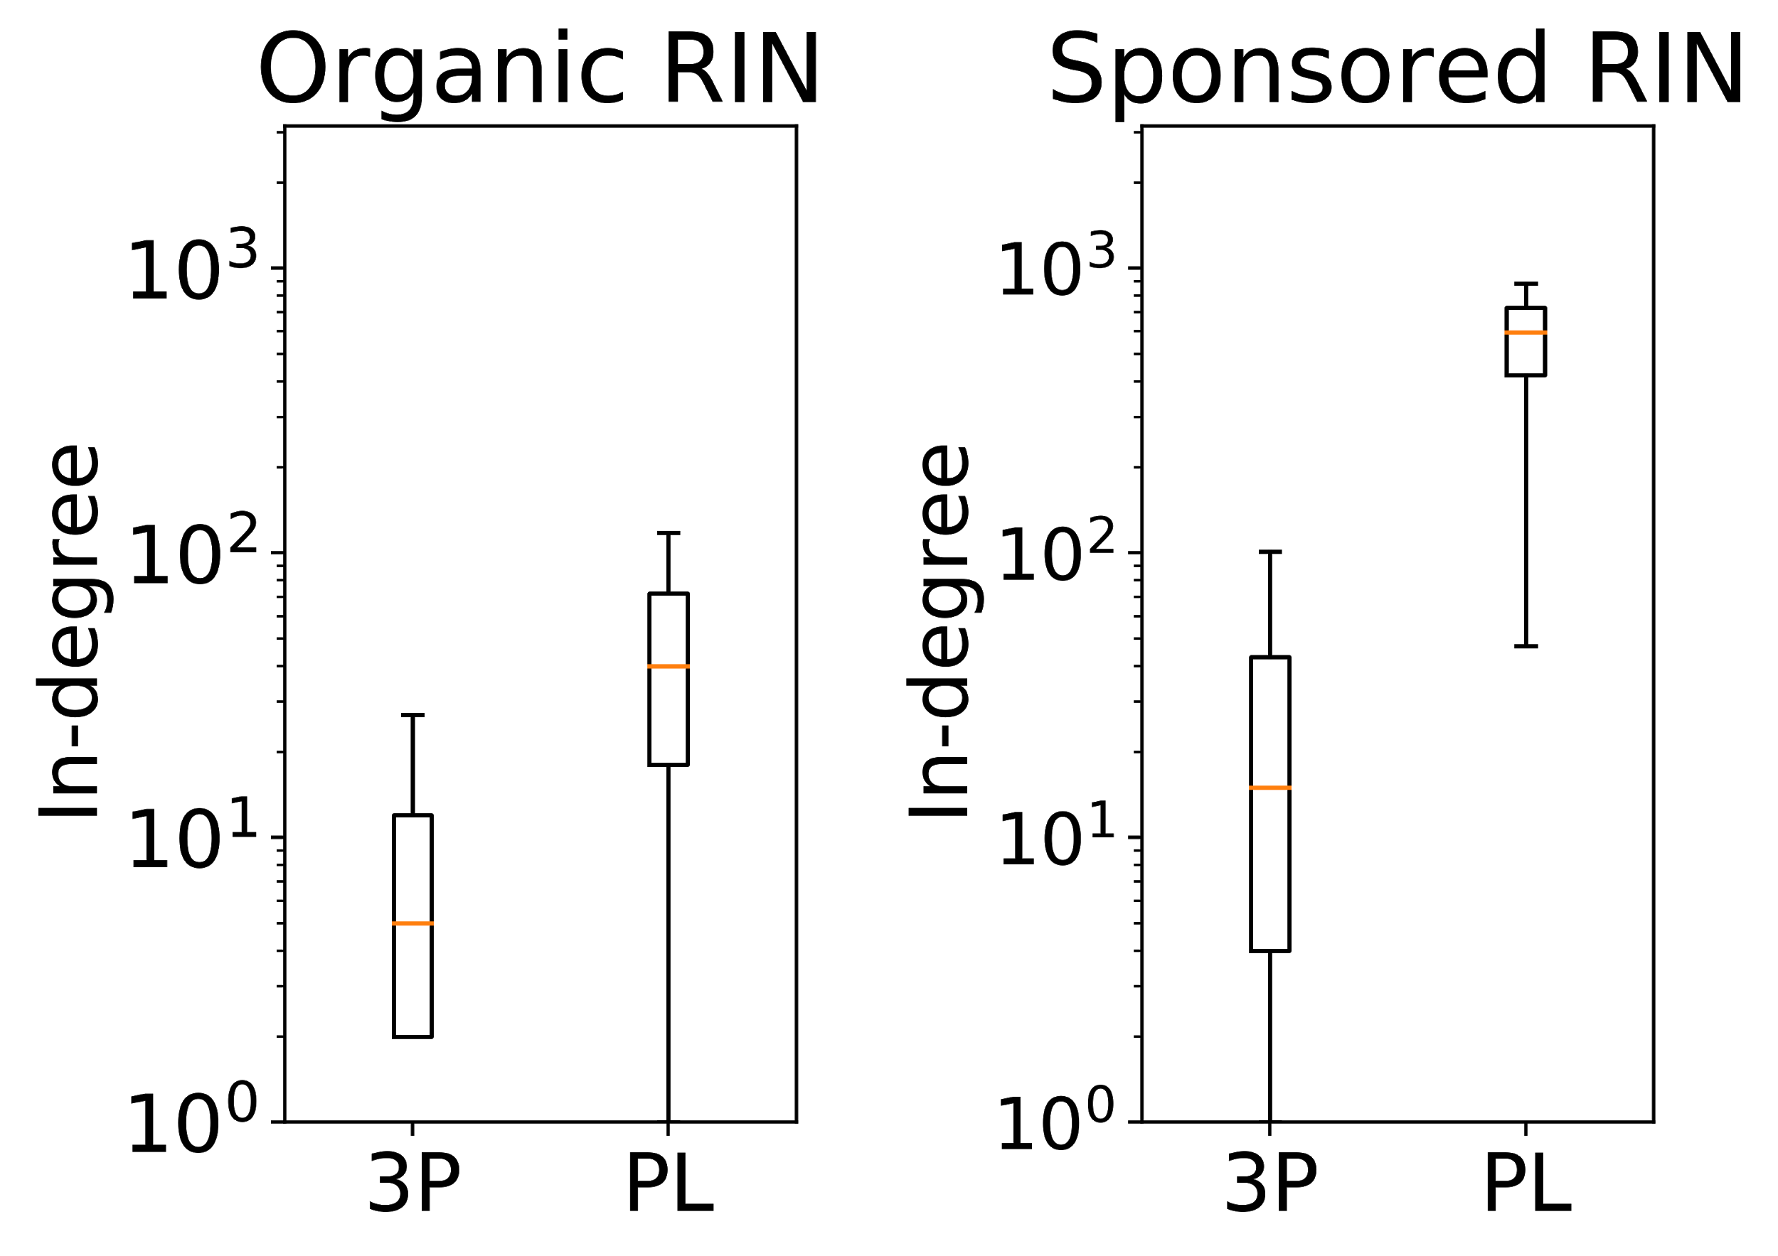
Promotion bias
Comparison of in-degree distributions of different kind of products.
*Y-axes are in log-scale.

Slide 176
Promotion bias
Comparison of in-degree distributions of different kind of products.
Considerable disparity in the in-degree distributions in the Organic RIN.
*Y-axes are in log-scale.

Slide 177
Promotion bias
Comparison of in-degree distributions of different kind of products.
Considerable disparity in the in-degree distributions in the Organic RIN.
Disparity further increases significantly in the Sponsored RIN.
*Y-axes are in log-scale.

